Slide 1

GLOBAL CYBERSECURITY THREATS (2015-2024)
SELSHA PP
07-08-2025

Slide 2
OBJECTIVE
To design an interactive Power BI dashboard that visualizes global cybersecurity threats from 2015 to 2024, helping stakeholders understand patterns, impact, and vulnerabilities.

Slide 3

Dataset Overview
Dataset Name : Global Cybersecurity Threats (2015-2024)
Source : Kaggle
Fields included :
* Attack Type
* Country
* Year
* Financial Loss (in millions)
* Number of Affected Systems
* Incident Resolution Time
* Target Industry
* Security Vulnerable
* Defense Mechanism Used

Slide 4
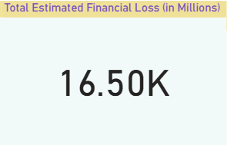
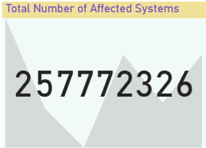
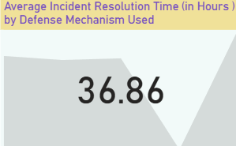
KEY PERFORMANCE INDICATORS (KPI)
Total Estimated Financial Loss (in Millions)
Total Number of Affected Systems
Average Incident Resolution Time by Defense Mechanism Used

Slide 5
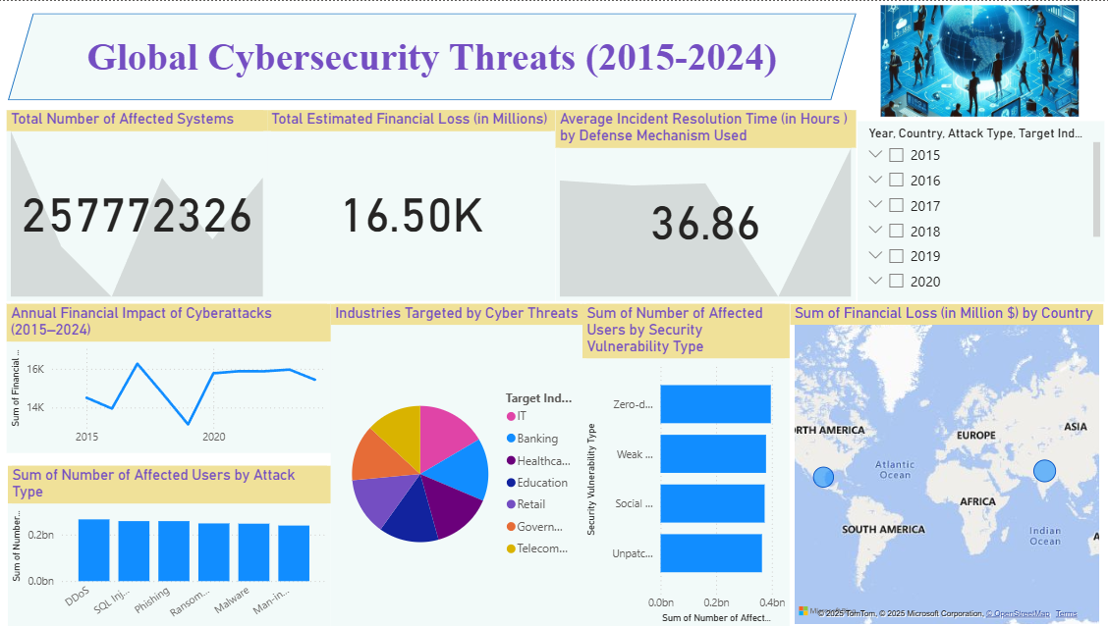
OVERVIEW OF DASHBOARD

Slide 6
KEY INSIGHTS
Cyberattacks and financial losses have grown significantly year-over-year.
Certain threat types like ransomware and phishing dominate.
Specific industries like finance and healthcare are frequent targets.
Some countries face more incidents than others, indicating targeted attacks.
Resolution times vary, suggesting differences in preparedness

Slide 7

CONCLUSION
- The dashboard enables a clear view of cyber threat trends over a decade.
- Stakeholders should prioritize defense strategies against top threats.
- Invest in reducing resolution time and improving vulnerability patching.
- Regularly monitor and update security frameworks based on insights.

Slide 8
Thank you !

